Slide 1


Submitted By: -
Ekhlakh Ahmad.
Reg No.: - 12209166.
Submitted To: -
Sarabjit Kumar Sir

Slide 2
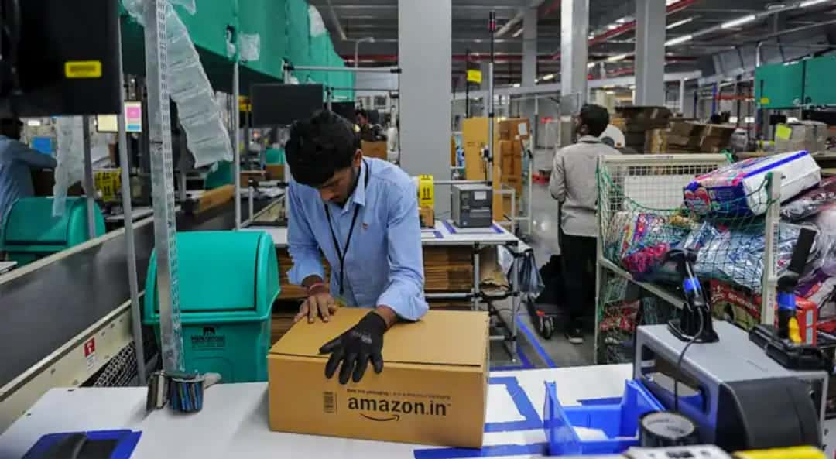
Brief About Company
Amazon is the World’s largest online retailer and a prominent cloud service provider.
Amazon is an American online business and cloud computing company.
It was founded on July 5, 1994 by Jeff Bezos.
Amazon is a vast Internet-based enterprise that sells books, music, housewares, electronics and many other goods.
By 1998, Amazon’s revenues had reached an impressive $600 million.
Amazon has also adopted automated processes for firing, as well as hiring.

Slide 3
Year of Existence with History.
It was founded on July 5, 1994 by Jeff Bezos.
On July 5, 1994 Bezos initially incorporated the company in Washington state with the name Cadabra.
After a few months, he changed the name to Amazon, Because a lawyer misheard its original name as “CADABER”.
On July 16, 1995, Amazon opened as an online bookseller, selling the world’s largest collection of books to anyone with World Wide Web Access.
Amazon was selling books in all 50 US states and 45 countries.
1997: Amazon.com debuts on the web.
By 1998, Amazon’s revenues had reached an impressive $600 million.
1999: The firm expands into selling toys, electronics, tools, and hardware, Bezos is named Time Magazine’s “person of the Year”.

Slide 4


Amazon Old LOGO
Amazon New LOGO

Slide 5
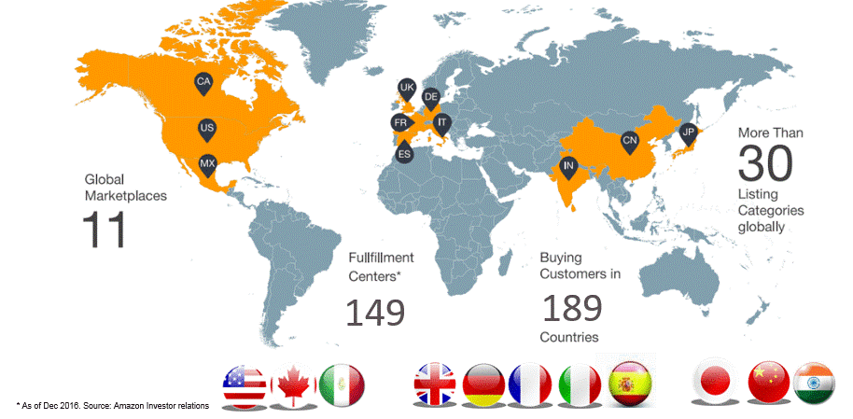
Country of Origin & Countries for Business.
Amazon is an USA(United State of America) company. As we know that it was started in Washington (America). So its origin is America.
Amazon currently has international marketplace centres in 15 countries.
There are some company country-
U.S
Canada.
U.K.
Germany.
France.
India. Etc.
But they shipped to over 200+ countries.

Slide 6
Revenue as per the NSE/NYSE(Last 5 Years).
Year | Revenue | Change
2022 | $485.90 B | 3.42%
2021 | $469.82 B | 21.7%
2020 | $386.06 B | 37.62%
2019 | $280.52 B | 20.45%
2018 | $232.88 B | 30.93%

Slide 7
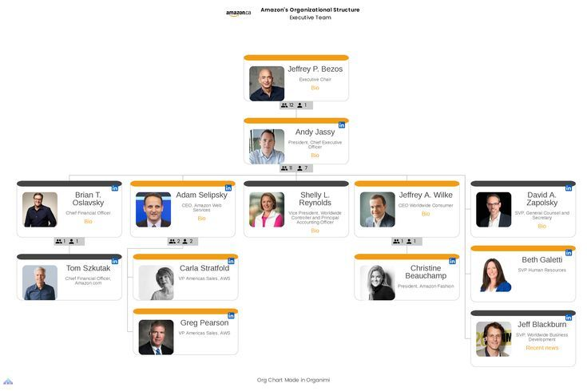
Leadership Hierarchy of the company

Slide 8
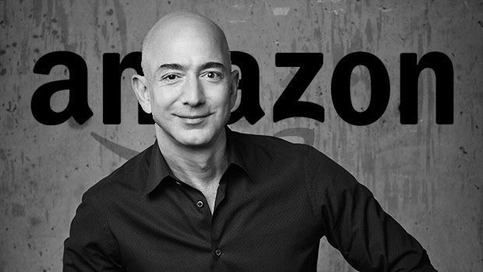
Jeff Bezos founded Amazon.com in 1994. Amazon’s mission is to be Earth’s most customer centric company. Amazon offers low prices and fast delivery on millions of items, provides thousands or movies and TV shows through Prime Video, designs and builds the bestselling kindle, fire and echo devices.
Jeffrey P. Bezos

Slide 9
References of LPU Alumni working Company
Name | Company Name | Linkedin ID, E-mail ID
Sravan Kumar | Cabgemini | linkedin.com/in/sravan-kumar-204474149

Slide 10
Employee Base (Country wise)
Amazon total number of employee in 2022 was 1,608,000
Amazon total number of employee in 2020 was 1292000
Amazon total number of employees in 2019 was 798000.
Amazon total number of employee in 2028 was 647.500

Slide 11
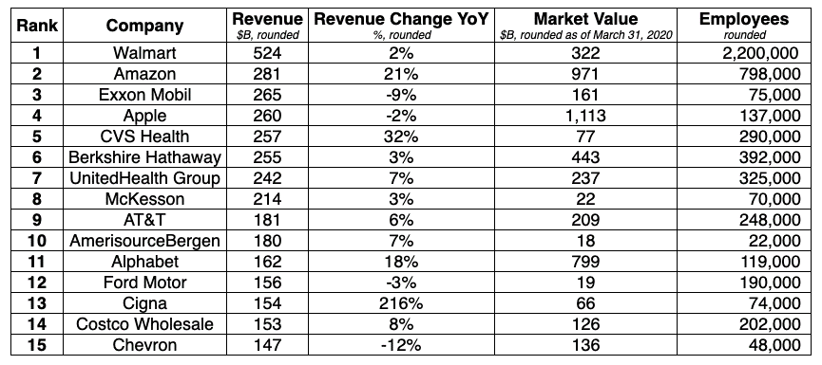
Rankings of the company(Forbes Fortune 500 etc).

Slide 12

Technologies used in the Amazon

Slide 13
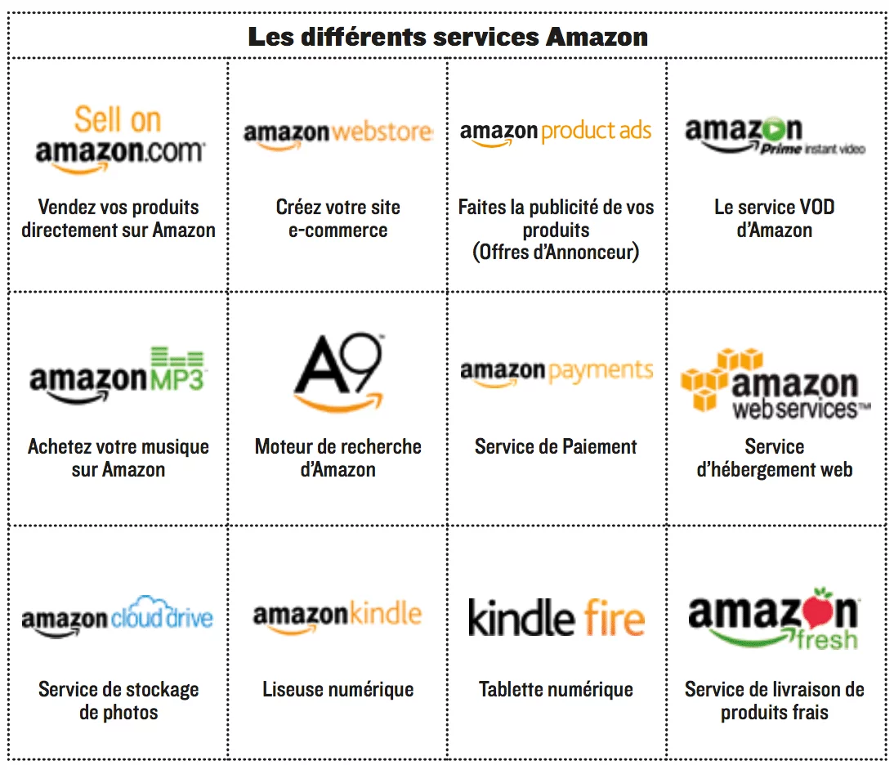
Major Products of the amazon with Clients.

Slide 14
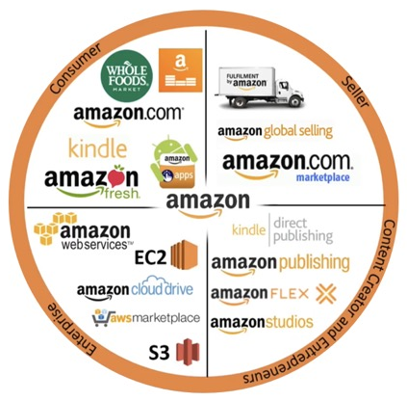
Major Services by the amazon with Clients.

Slide 15
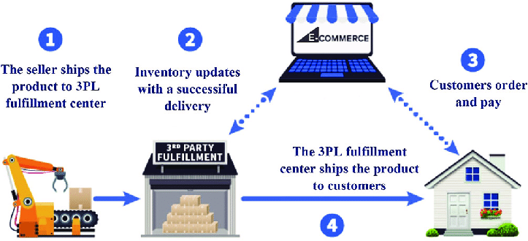
Operational verticals of the amazon with clients

Slide 16
Role you are interested with amazon
Amazon is a fast-paced company that has very high expectations of its employees.
Many aim to get at job at this US multinational technology company.
Because this a top company in the field/industry.
This company have a great reputation for customer service.
This company known for being a great place to work. Etc.

Slide 17
Packages offered by amazon for role
Job Title | Range | Average
Customer Service Associate | Rs. 162K – Rs. 403K | Rs. 252,293
SDE | Rs. 737K – Rs. 4m | Rs. 1643476
Operations manager | Rs. 562K – Rs 3m | Rs. 1244973
Software Engineer | Rs. 453K – Rs. 4m | Rs. 1270557
Data Analyst | Rs. 234K – Rs. 826K | Rs. 441145

Slide 18

Visits company gave to LPU Campus

Slide 19
Pros & Cons of the company you have considered for you
You have financial security
You get more perks and benefits
There are well-defined processes
You will have a better status
There are more career development opportunities
The cons of working for a large company

Slide 20
List of the references weblinks, articles etc.
https://www.careeraddict.com/
https://www.quora.com/
https://www.wikipedia.org/
https://w3techs.com/
https://www.aboutamazon.com/
https://www.linkedin.com/

Slide 21
The End
Start: -
SERVICE BASE

Slide 22

Tata Consultancy Services
Submitted By: -
Ekhlakh Ahmad.
Reg No.: - 12209166.
Submitted To: -
Sarabjit Kumar Sir

Slide 23
Brief About Company
Tata Consultancy Services (TCS) is an India multinational information technology.
IT services and consulting company with its headquarters in Mumbai.
It is a part of the Tata Group and operates in 150 locations across 46 countries.
TCS is the second largest Indian company by market capitalisation and is among the most valuable IT service brands worldwide.
The company is non-government and it is registered at Registrar or companies, Mumbai.
TCS Company Name is “Tata Consultancy Services limited.
TCS Company Founder Name is Faquir Chand Kohli, J. R. D. Tata, Tata Sons.
TCS Headquarter in Mumbai, Maharashtra.
TCS CEO Name – Rajesh Gopinathan (21 Feb 2017 – Present)

Slide 24
Year of Existence with History.
Tata Consultancy Services was founded in 1968 by a division of Tata Sons Ltd.
TCS acquired company name ICL 1903 in 1970.
After acquiring the company TCS started building software for a common process like financial accounting, share registry work, sales.
They started their first international assignment in the year 1971.
TCS was growing within a few years of its establishment.
After 7 years of its establishment, TCS crossed the $1 million mark in export revenue.
TCS opened Tata Research and Design Development Centre (TRDDC) in Pune, India in 1981 with the objective of focusing on computer-aided software engineering i.e. a structured, tool driven approach to software development using process automation.
in 1989 TCS signed a huge deal of $10 million
$2 million global e-business development facility at Mumbai.

Slide 25

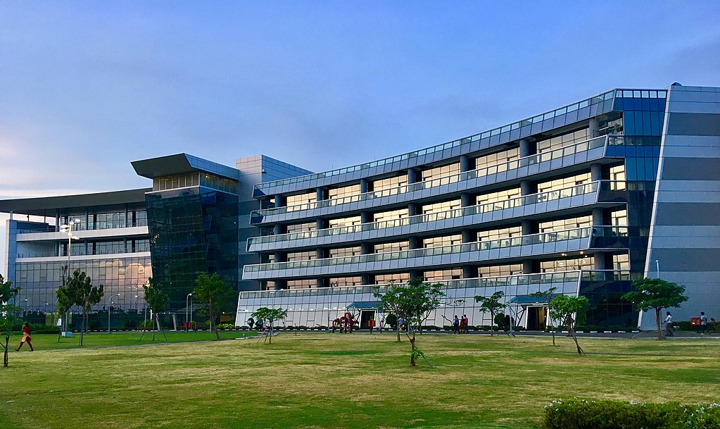

Slide 26
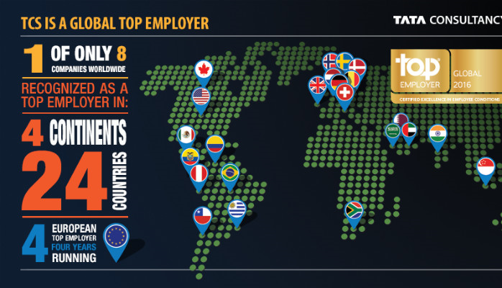
Country of Origin & Countries for Business.

Slide 27
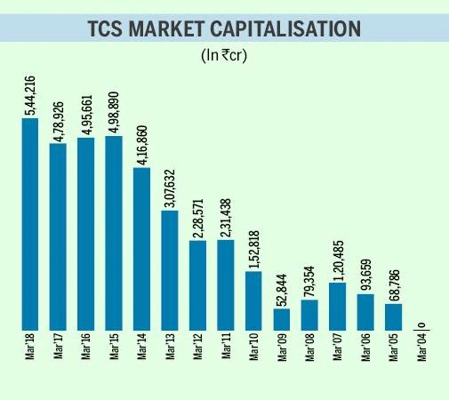
Revenue as per the NSE/NYSE(Last 5 Years).

Slide 28
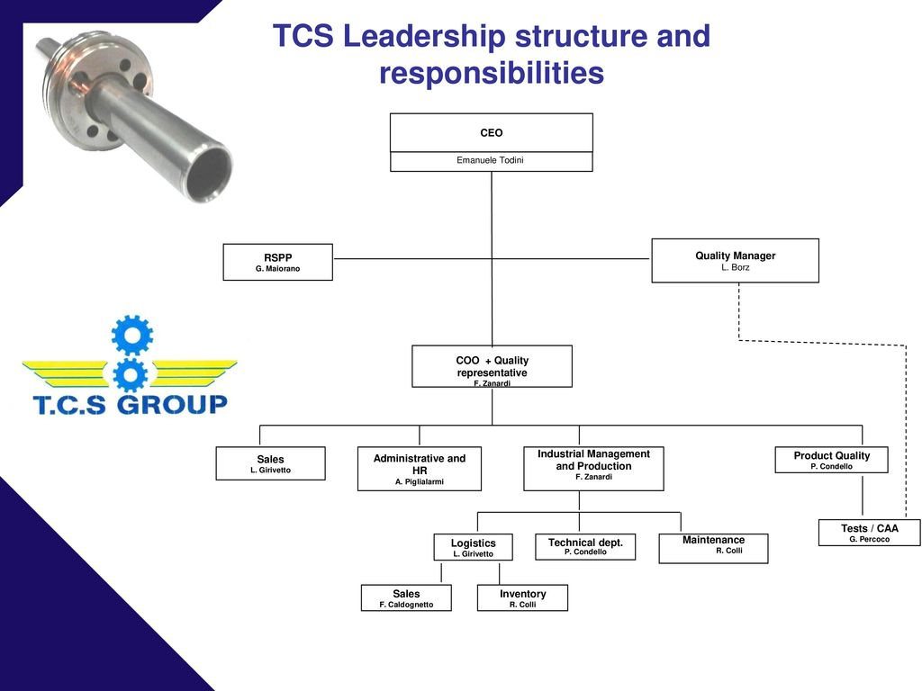
Leadership Hierarchy of the company

Slide 29
References of LPU Alumni working Company
Name | Company Name | Linkedin ID, E-mail ID
Sravan Kumar | Cabgemini | linkedin.com/in/sravan-kumar-204474149

Slide 30
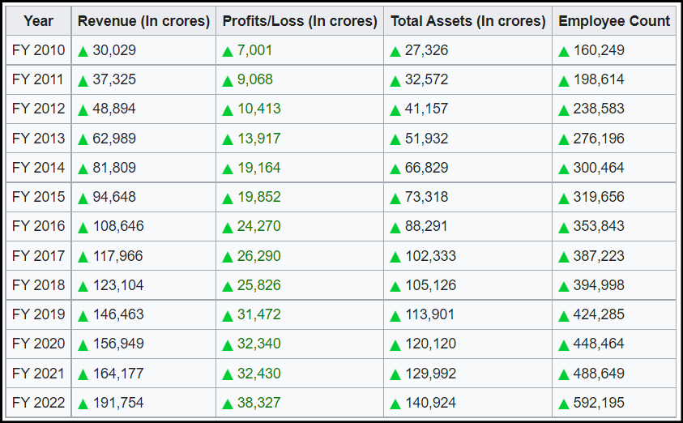
Employee Base (Country wise)

Slide 31
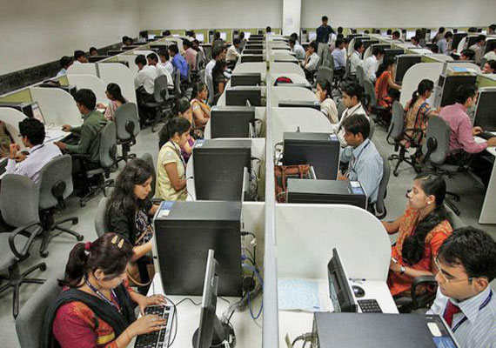

Slide 32
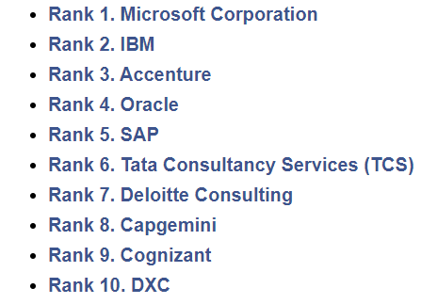
Rankings of the company(Forbes Fortune 500 etc).
Tata Consultancy Services (TCS) has been ranked as no. 1 Indian Multinational Information Technology (IT) firm which generate its revenue from various domains.
As of 2017, it has also been ranked 10th in the Fortune India 500 list.
It has surpassed Reliance industries by achieving Rs. 6.19 trillion market capitalization and has become the most valued firm of India.
TCS is on 6th Rank in Top 10 Information Technology (IT) companies in the world 2021.
Revenue: $25 Billion
Net Income: $5.2 Billion

Slide 33
Technologies used in the TCS

Slide 34
Major Products of the TCS with Clients.
Hospital management software (TATA – HMS)
TATA Bio-Suite
Master craft – modelling tool for software architecture.
ADEX – modelling tool & repository for storing application models.
Apollo (Insurance Software)
IIMS (Integrated Insurance Management System)

Slide 35
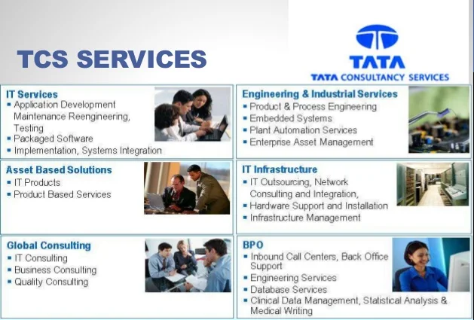
Major Services by the TCS with Clients.

Slide 36
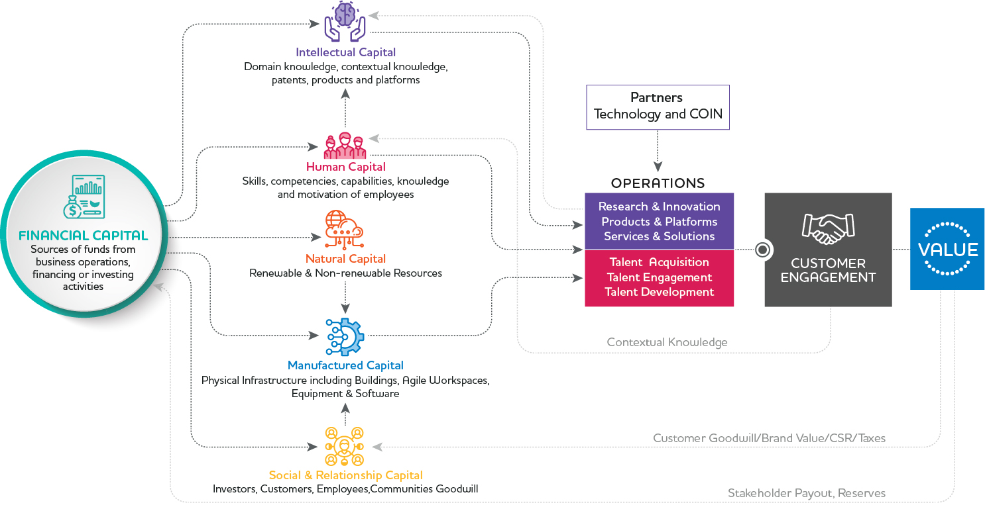
Operational verticals of the TCS with clients

Slide 37
Role you are interested with TCS
TCS is a fast-paced company that has very high expectations of its employees.
Many aim to get at job at this US multinational technology company.
Because this a top company in the field/industry.
This company have a great reputation for customer service.
This company known for being a great place to work. Etc.

Slide 38
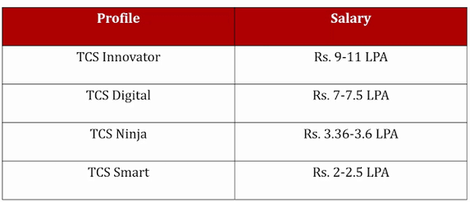
Packages offered by TCS for role

Slide 39
Visits company gave to LPU Campus

Slide 40
Pros & Cons of the company you have considered for you
You have financial security
You get more perks and benefits
There are well-defined processes
You will have a better status
There are more career development opportunities
The cons of working for a large company

Slide 41
List of the references weblinks, articles etc.
https://www.careeraddict.com/
https://www.quora.com/
https://www.wikipedia.org/
https://w3techs.com/
https://www.tcs.com/
https://www.linkedin.com/

Slide 42
The End
Thanks

